Slide 1

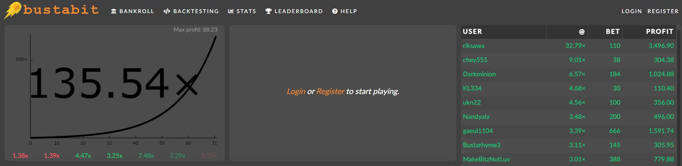
bustabit
What kind of gambler are you?
Notes:
- We are going to look at data from a bitcoin betting game called bustabit, and try to categorise certain betting patterns
- It’s a very simple game:
- choose how much you want to stake (in bits, 1 millionth of a bitcoin)
- watch the multiplier go up
- at any point you can cash out, and get your stake multiplied by that amount
- but at any point the game could bust, and you lose your stake
- to maintain the house edge, in 1/100 games everyone will bust
- what data do we have?
- individual user's outcome in a particular game
- 1.5 month period in 2016, end of October to mid December. For those who care, BTC was trading $700-775 back then
- interesting to see if there are any patterns that reveal what type of player you are
- do you have a high risk tolerance, the Midas touch, or perhaps a tendency to rage quit

Slide 2
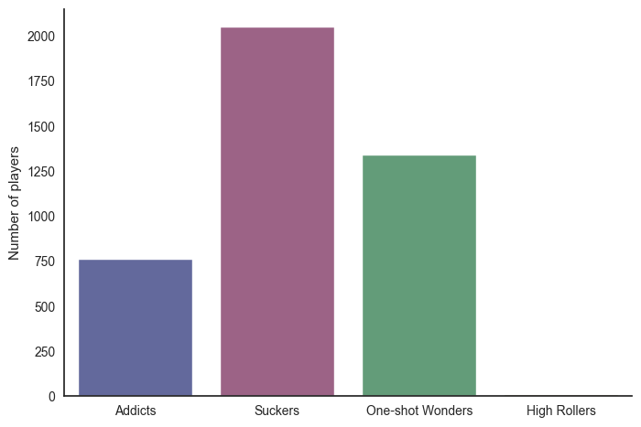
Player Groups – KMeans clustering
42,152 games
4,149 unique usernames
758 Addicts
2,048 Suckers
1,339 One-shot Wonders
4 High Rollers
Notes:
- in this short time period we have just over 42k unique games, involving 4k unique users
- Using KMeans clustering algorithm, we have put the players into 4 categories

Slide 3
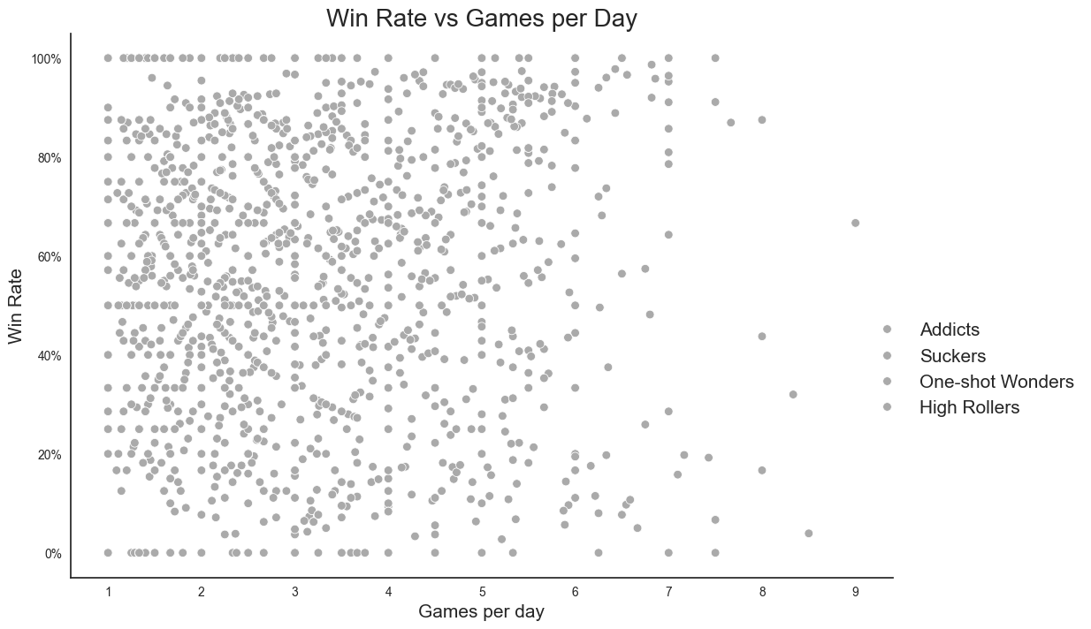
Notes:
Using the KMeans algorithm was extremely useful, as it’s pretty hard to see clear patterns from the data
This chart is one example of two key features from Principal Component Analysis plotted against each other – we have average games played per dayon the bottom, and the overall win rate on the left

Slide 4
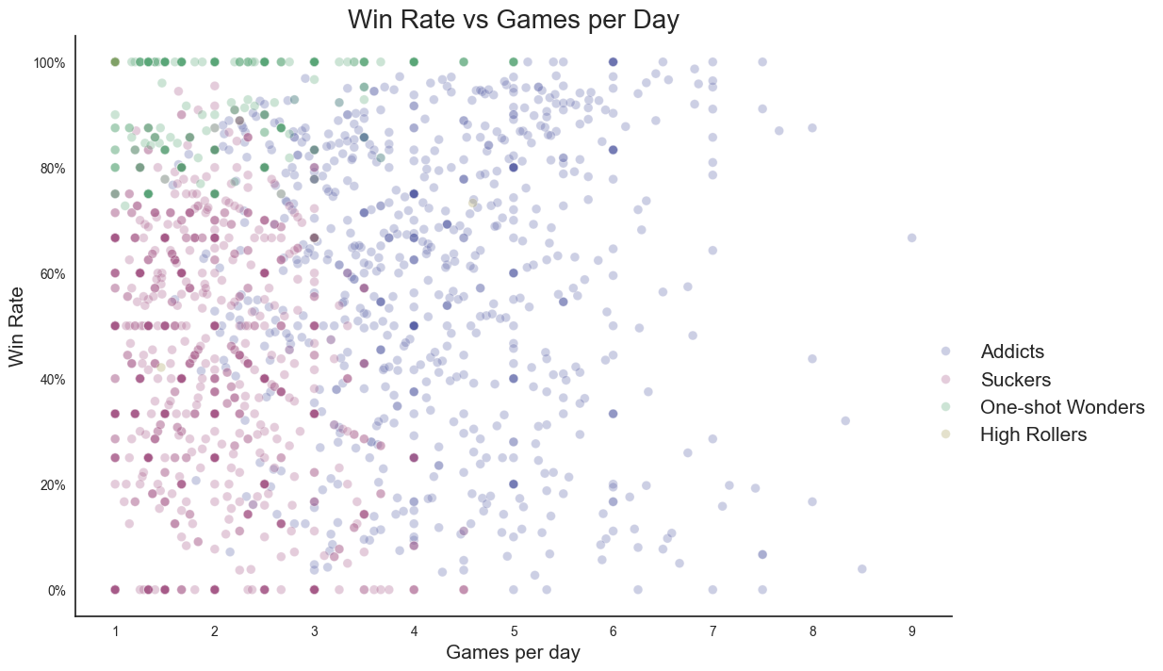
Notes:
- At first the clustering results may not be much clearer, but we can start to see some patterns emerging even here

Slide 5
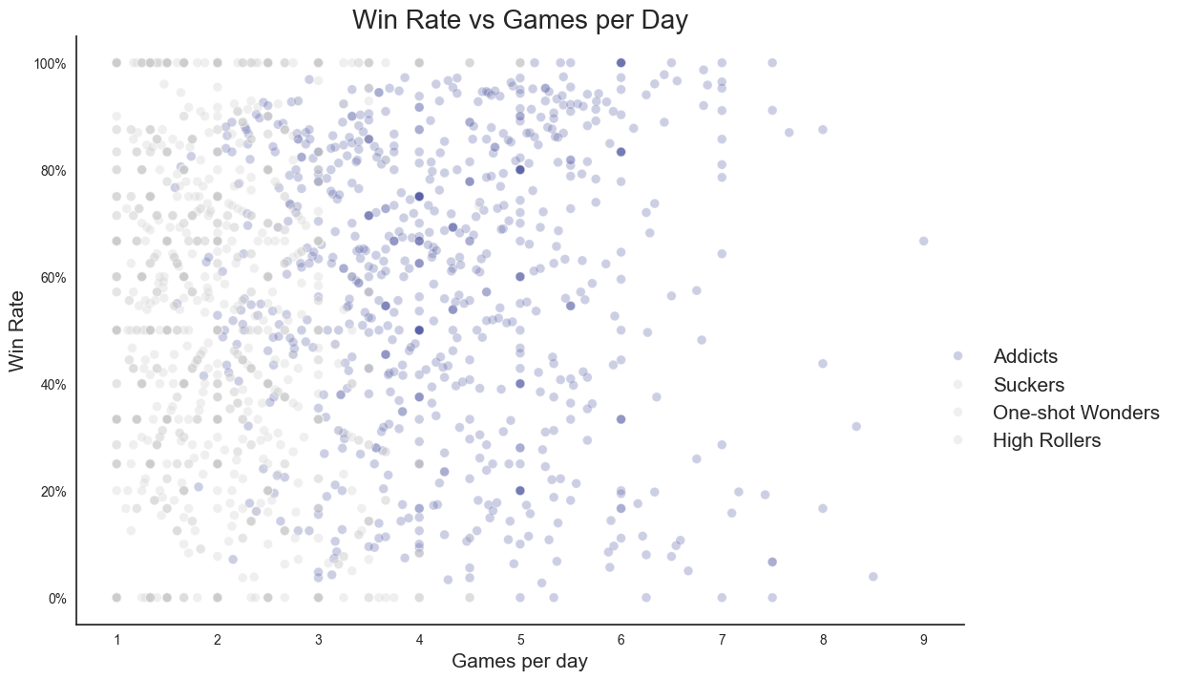
Notes:
Addicts are on the right of this chart – they play a lot – and a good spread of success rates

Slide 6
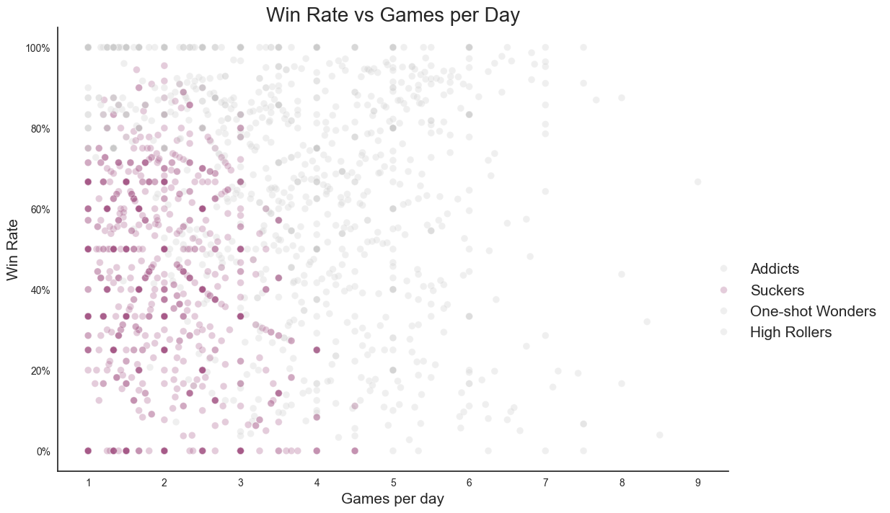
Notes:
The Suckers are in the lower left – low down because they don’t do very well, and left as they play less than the addicts, unsurprisingly

Slide 7
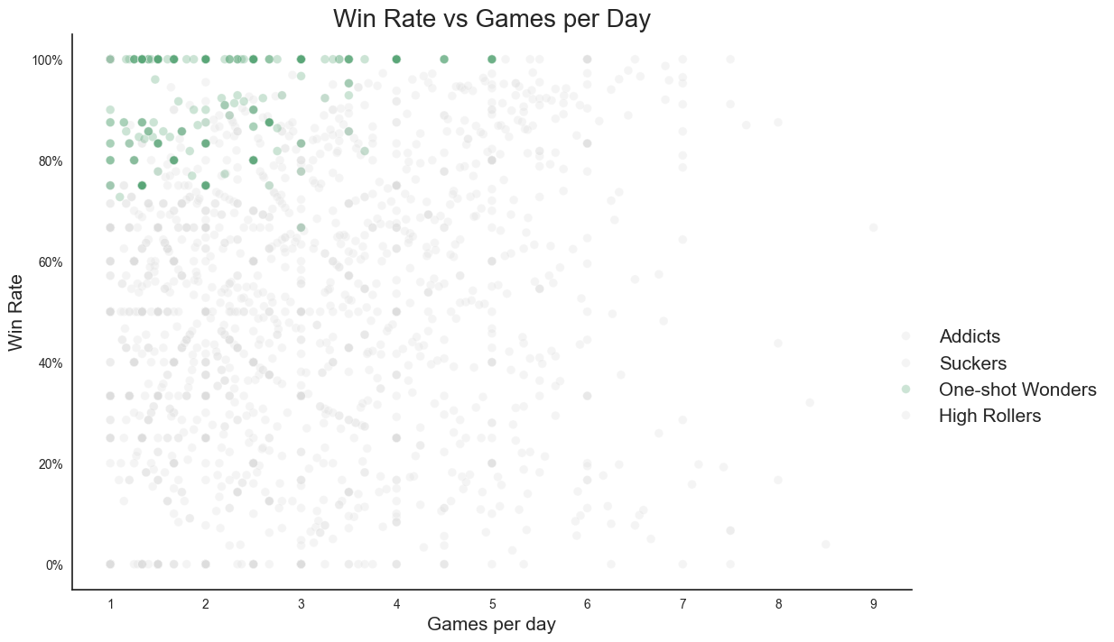
Notes:
And the One-shot Wonders are congregated in the top left – they don’t play many games, and they don’t need to because they usually win.
But let’s look a bit deeper into these categories…

Slide 8
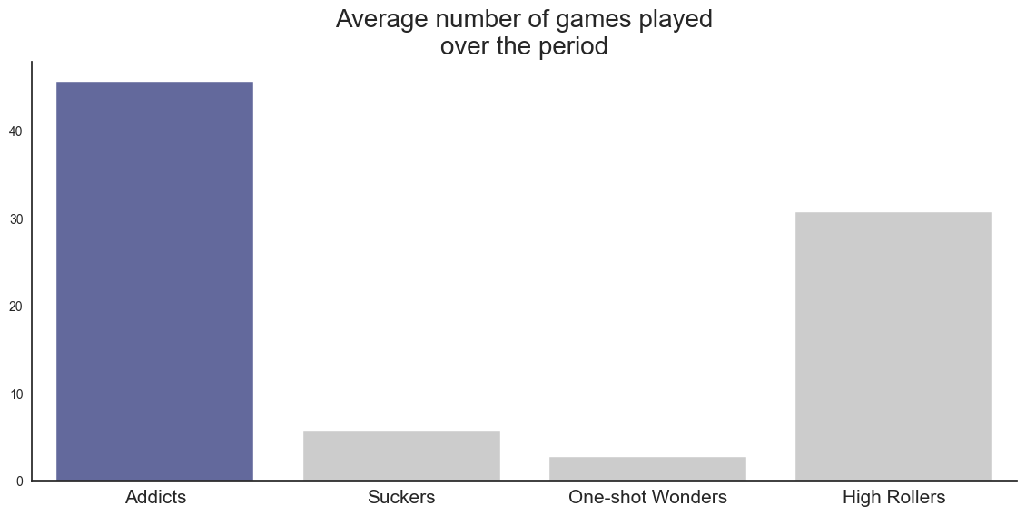
Addicts – they love to play…
Notes:
Starting with the Addicts:
The most obvious sign of an addict, and one the biggest factors from Principal Component Analysis – how many games did they play over the period?
The High Rollers bar is dragged higher by one of the four players, who played 101 times.
As we can see, the Addicts category play way more than everyone else.

Slide 9
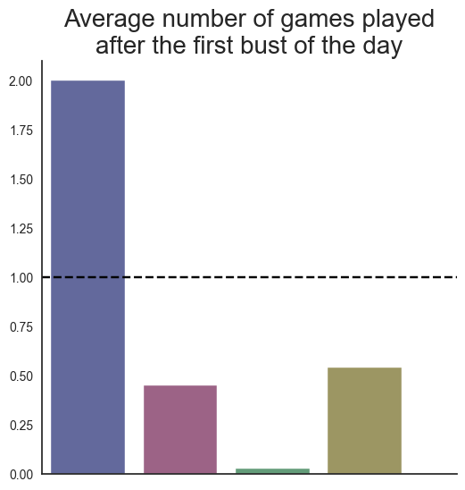
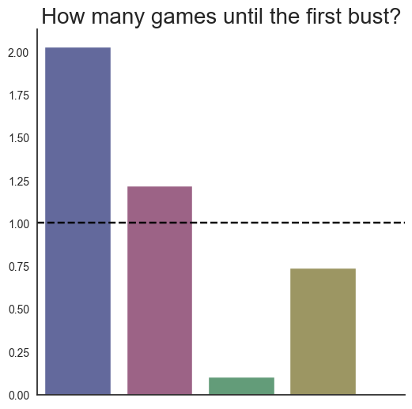
… and they keep coming back for more
Notes:
- Not only that, but another classic sign of addiction – when they bust, they keep playing
On the left we can see how many games they play after the first bust of a playing session – addicts will keep going back to the well, while in the other categories the majority of players don’t even play 1 more game, they give up straight away
And this is despite the fact that on average it takes longer for the addicts to bust (on the right)

Slide 10
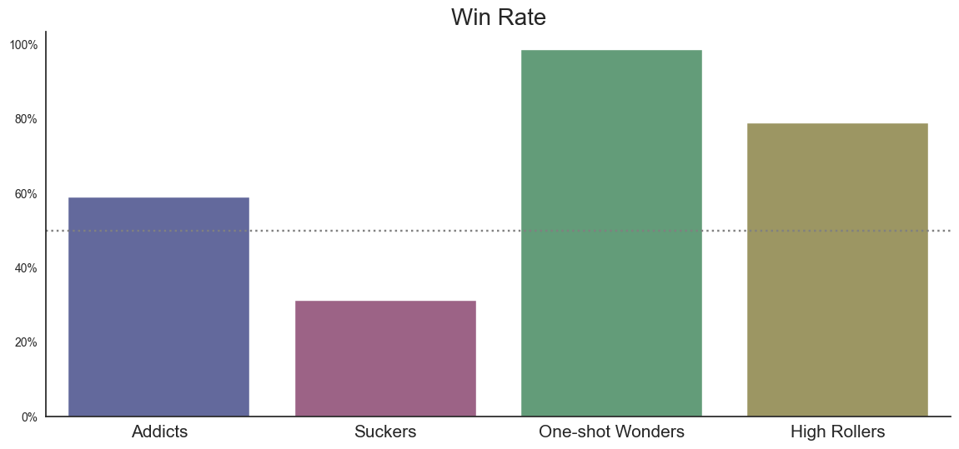
Suckers – a chart says a 1000 words
Notes:
- The Suckers are the only group below the magic 50% success rate, meaning a key characteristic is that they lose more than they win

Slide 11
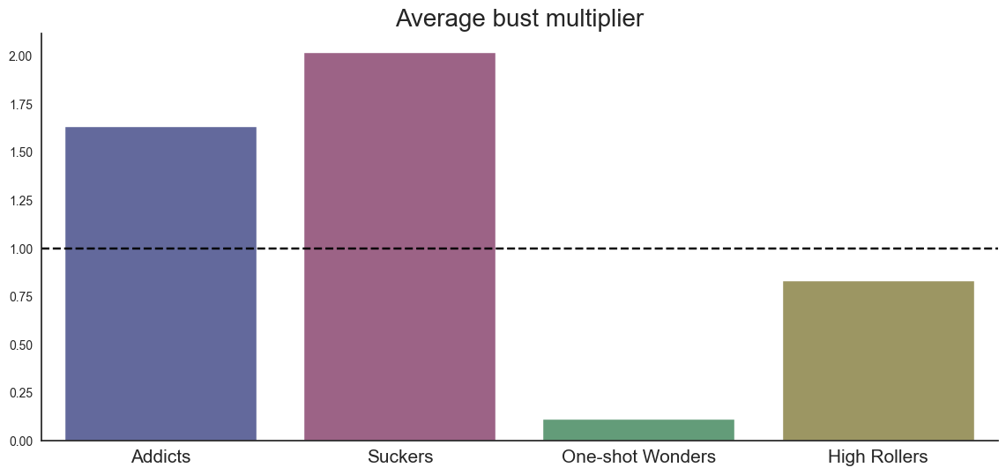
Best at something?
Notes:
Average bust multiplier – what the end multiplier was ONLY for the cases where the users lost
The game starts at 1x, which is this dotted line. If a player never lost, their score is 0 – so for the categories below the line, they had enough players that never lost to drag down the average.
- So what does this mean for the Suckers? It shows that on average, they waited the longest before they lost.
- So it’s not that the Suckers are unlucky per se, they just generally suck at this game.

Slide 12
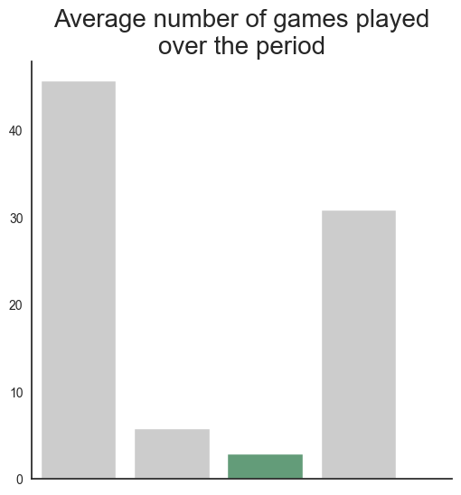
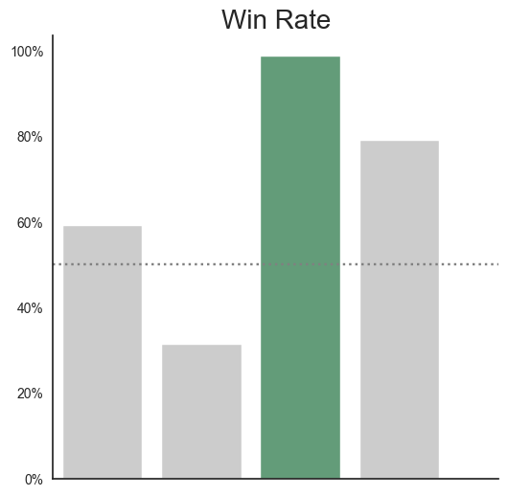
One-shot Wonders – in the name
Notes:
One-shot Wonders – it’s in the name. They play very little, but have a very high-success rate

Slide 13
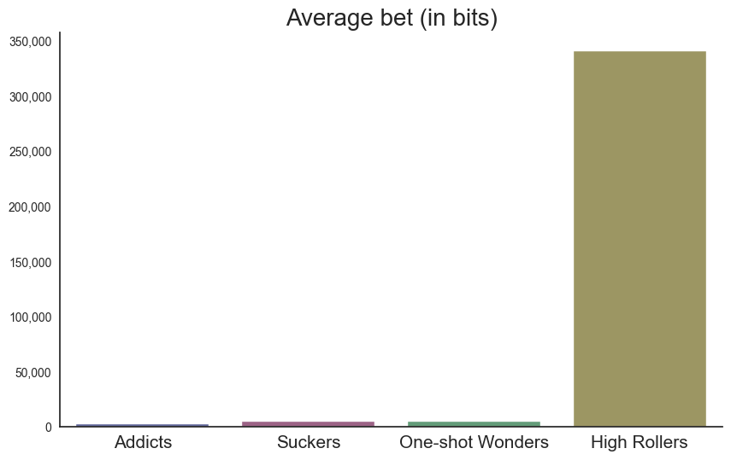
High Rollers – there’s only one thing that counts
4 players
123 games played
22.18m bits wagered
69.1% win rate
7.2m bit net profit
Notes:
High Rollers – where could they show up in the data?
Average bet size – everyone else is basically playing for chicken feed.
There are only 4 players in this category, so let’s have a look at how they did…
22.18m bits = $16k (2016 price), $1.5m (today’s price)

Slide 14
Challenges & Lessons
Creating data features
NaNs
Despair at the PCA results
More data

